Slide 1

University Institute of Liberal Arts and Humanities
Course Name- Communication Skills
Course Code-23PCH-105
Digital Communication – Blogs & Websites
DISCOVER . LEARN . EMPOWER

Slide 2
COURSE OBJECTIVES
The Course aims to:
1 | Augment students overall communication and interpersonal skills by making them realize the importance of good oral and written English Language in professional life.
2 | Enrich their reading capability with special emphasis on expanding vocabulary and grammatical formations.
3 | Build exceptional speaking, reading and writing skills by correcting grammatical errors and pronunciation through practice.
4 | Enhances soft skills by fostering self awareness, confidence and a positive attitude in students’ ability to communicate effectively in English.

Slide 3

COURSE OUTCOMES
Space for visual (size 24)
On completion, the students are expected to
CO Number | Title | Level
CO1 | Apply appropriate Listening, Speaking, Reading and Writing Skills (LSRW Skills) with correct non-verbal cues to attain expertise in soft skills. | Apply
CO2 | Apply correct contextual and comprehensible written text in the form of paragraph writing, short compositions business correspondence, using logical support and argument in a wide range of communication situations. | Apply
CO3 | Demonstrate linguistic competence while speaking and during presentations through accuracy in grammatical usage, vocabulary, pronunciation and intonation. | Apply
CO4 | Evaluate information as critical readers, speakers and writers applying ethics in communication and being sensitive in cross cultural communication. | Evaluate
CO5 | Create original, digital content for websites, blogs, vlogs and personal social media profiles etc. | Create
https://getvoip.com/uploads/business-communication-methods.jpg

Slide 4

What is a Blog?
A blog (a shortened version of “weblog”) is an online journal or informational website displaying information in the reverse chronological order, with the latest posts appearing first, at the top.
A collection of skills that one needs to run and supervise a blog.
Entails equipping a web page with tools to make the process of writing, posting, linking, and sharing content easier on the internet.

Slide 5

Benefits Of Blogs
Start a new business
Become a better writer
Express yourself
Build a network
Get more client for your existing business
Improves writing skills
Increases agility
Boosts search engine optimization

Slide 6
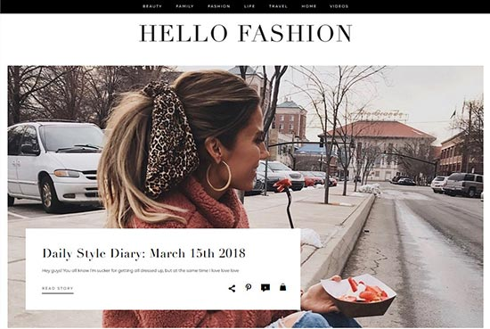
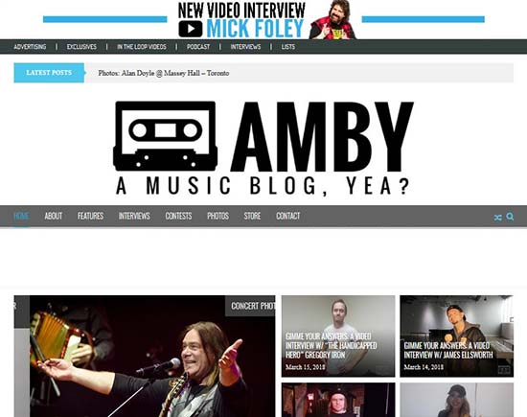
Example
https://encrypted-tbn0.gstatic.com/
https://lh3.googleusercontent.com/

Slide 7
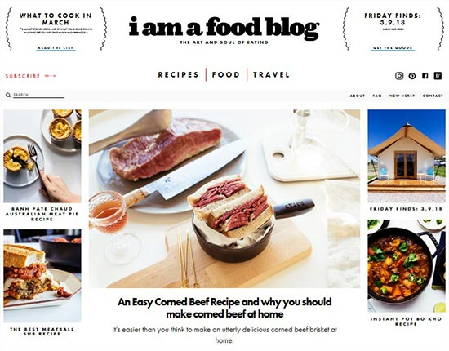
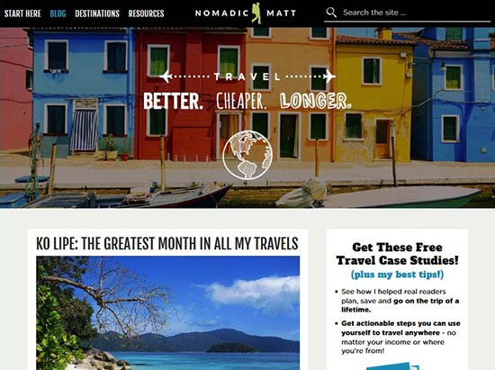
Example
https://lh3.googleusercontent.com/
https://lh3.googleusercontent.com

Slide 8

How to start a Blog
Step 1: Plan your blog post by choosing a topic, creating an outline, conducting research, and checking facts.
Step 2: Craft a headline
Step 3: Write your post
Step 4: Use images to enhance your post, improve its flow, add humor, and explain complex topics.
Step 5: Edit your blog post.
https://www.istockphoto.com/photos/start

Slide 9

How to write a Blog
Magnetic headline
Compelling leads
Useful subheads
Informative and engaging body
Appealing graphics
Powerful call to action
Relevant internal link
Good meta description

Slide 10
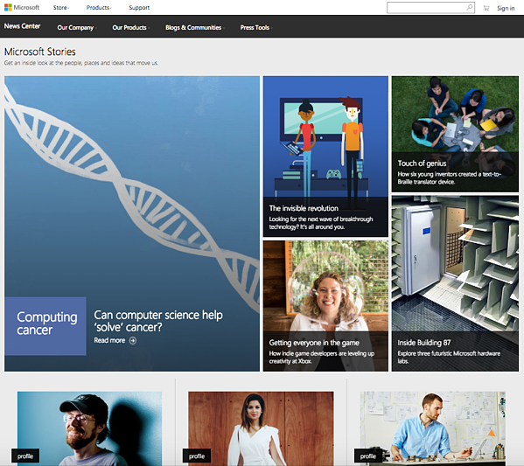
10 Best Blog Sites for 2021
WordPress.org – Best for Self-Hosted Blogs.
WordPress.com – Best for Free Blogs. ...
Wix.com – Best for Small Websites. ...
Joomla.com.
www.Medium.com
Ghost.org. ...
Squarespace.com. ...
Weebly.com.
Blogger.com
Tumblr.com
https://blog.hubspot.com/blog/tabid/6307/bid/34143/12-inspiring-examples-of-beautiful-blog-homepage-designs.aspx

Slide 11


Using Multimedia
Blogs give writers the opportunity to use design, images, audio, and video to supplement their writing. Take advantage of these innovative ways to enhance your presentation!
Use appropriate content, size, and quality Make sure your chosen images complement the layout of your text visually.
When linking to an online video, consider using a screen shot from that video as your hyperlink. A screen shot can make a reader more likely to click on a link. It can demonstrate the clip’s relevance to your post.

Slide 12

How to maintain a successful blog
Make post titles eye-catching but also reasonably accurate.
Consider using the tag function in each post. This will help guide readers through your content thematically instead of chronologically. Keep tags consistent, including punctuation.
If your hosting platform allows, link to similar blogs in order to increase your traffic.

Slide 13

How to maintain a successful blog
Be aware that you are potentially addressing people with very different knowledge bases and cultural assumptions than yours.
Handle comments with care. As the blog’s creator, the way you handle dissenting or inflammatory voices sets the tone for your readers.

Slide 14

Vlogs
A blog that publishes video content.
Started as a form of self expression
Intends to get attention, a market or an audience
A personal website or social media account where a person regularly posts short videos.

Slide 15


Slide 16


Importance of Vlogs
5 Billion videos are seen every day on YouTube
Cross – cultural communication and awareness
Education
Connecting with people
Lively touch
Revenue
Making a difference

Slide 17


How to create a Vlog
Do’s
Get some experience first
Do plan out your day
Be natural with respect to the script
Use templates, shortcuts and hotkeys
Don’ts
Don’t Film Everything
Don’t Spend too Long On a Script… Or Your Video
Don’t Worry About Equipment (But Be Aware of Bad Audio)
Don’t Forget About Your Audience

Slide 18

Content is the king
Gripping Storyline
Hook your viewers
Effortless Introduction
Structure your content over something specific
Give a visual index
Call your viewers to action

Slide 19

Podcasts
A digital audio file made available on the Internet for downloading to a computer or mobile device, typically available as a series, new installments of which can be received by subscribers automatically.
Podcasting started as mostly an independent way for individuals to get their message out there and build a community of people with similar interests.

Slide 20

Some Famous Examples

Slide 21

Benefits of Podcasts
Easy to create
Informative
Easy to distribute
Accessible
Impactful marketing tool
On demand
https://www.bertrandt.com/en/career/why-bertrandt/benefits

Slide 22

Content Strategy
Everyone is self absorbed except you.
Make it actionable
Visual impact
Adjust your content sharing according to the channel
Use ego bait
Dialogic (Interviews)
Ask your audience
https://cdn.searchenginejournal.com/wp-content/uploads/2019/05/10-Reasons-Why-You-Need-to-Podcasts-to-Your-Content-Repertoire-760x400.png

Slide 23
Websites
What does Website mean?
A website is a collection of publicly accessible, interlinked Web pages that share a single domain name. Websites can be created and maintained by an individual, group, business or organization to serve a variety of purposes. Together, all publicly accessible websites constitute the World Wide Web.
A website is also known as a web presence.

Slide 24
Types of Websites
Static
Can be created quickly
Economical
Quick delivering speed
Simple in structure.
Content of Web pages can not be change at runtime.
Dynamic
High-end programming, easily updated.
It is neat and well organized .
Popular with Electronic-commerce sites and shopping portals
Attractive looking due to advanced graphics
Content of Web pages can be changed.

Slide 25

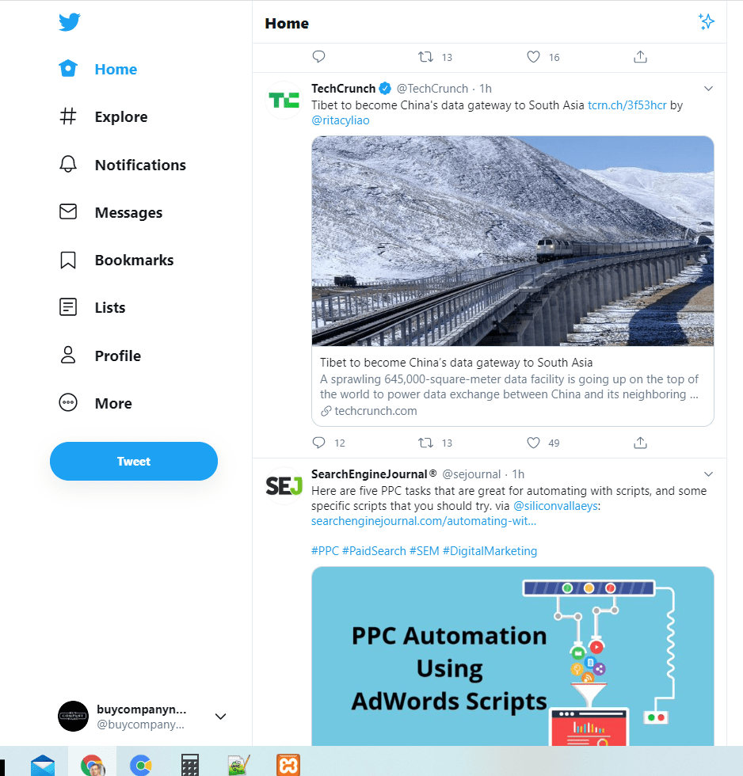
Examples
Static Website
Hartwell Insurance
Dynamic Website
Twitter

Slide 26
How to write for a website
Use keyword that user might relate to. This optimizes the search engine.
Divide your content.
Front-load the important information
Use pronouns. The user is “you.” The organization or government agency is “we.”
Use active voice. “The board proposed the legislation” not “The regulation was proposed by the board.”

Slide 27
How to write for a website
Use short sentences and paragraphs.
Use bullets and numbered lists.
Use clear headlines and subheads. Questions, especially those with pronouns, are particularly effective.
Use images, diagrams, or multimedia to visually represent ideas in the content. Videos and images should reinforce the text on your page.
Use white space. Using white space allows you to reduce noise by visually separate information.

Slide 28
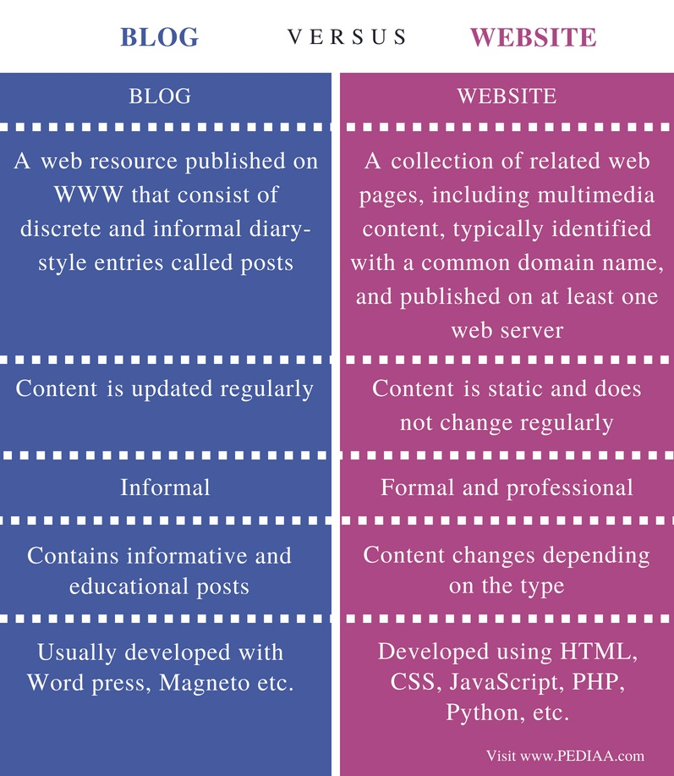

Slide 29
Applications
Contact people all over the world for free (or inexpensively)
Market expansion.
Document interactions
Online Presence 24/7.
Information Exchange.
Credibility.
Consumer Insights.
Advertising.

Slide 30
Assessment Pattern
Students are assessed on the basis of the following parameters:
Hourly Tests - 2
Assignments
Surprise Test
Quiz
Student Engagement
End Semester Exam

Slide 31
References
www.blog.hubspot.com
www.wpbeginner.com
www.wordpress.com
https://www.spiderwriting.co.uk/static-dynamic.php
https://www.toppr.com/guides/business-correspondence-and-reporting/writing-formal-mails/conventions-sample-mails/
blogging-introduction.original.pdf (duke.edu)
7 Secrets To Producing Engaging Podcast Content (forbes.com)

Slide 32
THANK YOU
For queries
Email: communicationskills.uilah@gmail.com

